Slide 1


Module 13
Evidence-Based Practices Across the Tiers in Secondary Settings

Slide 2

Secondary RTI Series Overview
Module 11: Overview of Secondary RTI Implementation
Module 12: Early Warning Systems in Secondary Settings
Module 13: Evidence-Based Practices Across the Tiers in Secondary Settings
Notes:
This is the third module in a 3-part series designed to increased knowledge and skills to implement RTI at the secondary level.

Slide 3
Module 13 Objectives
Participants will be able to:
Define and explain the relationship among RTI, evidence-based practices (EBPs), and high leverage practices (HLPs).
Support implementation of EBPs and HLPs across the tiers of prevention within a secondary multi-tiered system of support.
Notes:
This is the third module in a 3-part series designed to increased knowledge and skills to implement RTI at the secondary level.

Slide 4
THINK-PAIR-SHARE
What comes to mind when you think of evidence-based practices, or EBPs?
What would you like to learn more about in regard to EBPs in secondary settings?
Discuss
Notes:
Provide partners 3-4 minutes to discuss these two questions. Depending on group size, elicit 3-4 responses from the group and connect these to the objectives of the session.

Slide 5
RTI Overview
Notes:
Trainer Notes: This section is a brief overview of RTI as presented in Module 11: Overview of Secondary RTI Implementation.

Slide 6


Response to Intervention
RTI integrates assessment and intervention within a schoolwide, multilevel prevention system (i.e., multi-tiered system of support, or MTSS) to maximize student achievement and reduce behavior problems.
RTI is not a special education initiative; it is an educational initiative for all students, including those at risk, students with language differences, and students with disabilities.
Source: National Center on Response to Intervention.
Notes:
The Center on RTI has a definition (taken from the “What Is RTI?” placemat) for RTI that includes what we consider to be its essential components. Read the slide.
It is important to point out that RTI is a schoolwide prevention system, not a prereferral process for special education, and it is multilevel versus multitier. Think of RTI as a framework or prevention model that is designed to provide all students with the high-quality instruction that they need to be successful in school. This prevention system addresses the needs of students on or below grade level, with a focus on those at risk, to prevent further or future poor academic or social outcomes. RTI addresses the needs of all students, including students with disabilities and students with language differences.
Source: Center on Response to Intervention at American Institutes for Research.

Slide 7
RTI Focus Area for
Secondary Setting
Elementary RTI models are NOT considered appropriate for secondary schools.
Before implementing RTI in secondary settings, teams must determine the focus of implementing an RTI model.
  If prevention, which negative consequences will be the focus of the prevention efforts?
  If proficiency, what areas move students toward proficiency?
Notes:
Read the slide.
Answers to questions like these assist secondary schools in developing RTI models that are likely to produce positive outcomes for students. When the outcomes and design of the RTI model match the identified needs of the school and its students, schools are more likely to experience higher levels of staff ownership, fidelity of implementation, and improved student outcomes.

Slide 8
RTI at All Grade Levels
 | Focus | Outcomes
Elementary School | Prevention of poor learning outcomes Schoolwide, early intervention | Improvement in basic literacy and math skills Appropriate identification of at-risk students
Middle School | Dropout prevention Prevent poor learning outcomes in HS | Prepared for HS success Credits/Proficiency on state exams
High School | Dropout prevention Supplemental intensive support Content recovery Targeted grades/populations | Improve graduation rate Pass core courses/exams
Notes:
RTI is not the same for all grade levels. The primary differences in elementary and secondary RTI models are the focus and desired outcomes.
Middle school or junior high school models vary based on the needs and design of the school. In some cases, 6th grade RTI models look more similar to elementary models. However, 7th and 8th grade models are more similar to high school models.

Slide 9
Across the Tiers
 | Tier I | Tier II | Tier III
Instruction/ Intervention Approach | Comprehensive, research-based curriculum and differentiated based on students’ needs | Supplemental, evidence-based interventions; supports core instruction | Supplemental, customized, intensive, systematic, evidence-based instruction that targets areas of greatest need; supplements core instruction
Group Size | Whole group with flexible grouping | Small, homogeneous grouping (1:3-1:5) | Small, homogeneous grouping (1:1-1:3)
Assessment | Screening, 3 times yearly | Biweekly | Weekly
Population Served | All students | Students identified as at risk (10%–15%) | Significant and persistent learning needs, nonresponders (1%–5%)
Notes:
Trainer Notes: Provide 2-3 minutes for participants to review the chart. Ask what similarities and/or differences they notice across the tiers and briefly discuss.

Slide 10
Varying Evidence Standards
Research-Based
Evidence-Based
Recommended for Tier I across subjects
Components have been researched and found to be generally effective
Curriculum materials have not been rigorously evaluated as a package
Recommended for Tier 2 and Tier 3
Materials evaluated using rigorous research design
Evidence of positive effects for students who received the intervention
Notes:
There are varying levels of evidence for instruction and interventions delivered within an MTSS framework.
Research-based curriculum is recommended for Tier I, or core instruction, across subjects. This means that the components have been researched and found to be generally effective, although the curriculum materials have not been rigorously evaluated as a whole.
Evidence-based interventions are recommended for Tier II and Tier III. These materials are evaluated using rigorous research design, and there is evidence of positive effects for students who received the intervention. This means that programs have been rigorously evaluated as a whole, and that the specific intervention program was found to have positive effects for students receiving the intervention program.

Slide 11
Interventions Within an
RTI Framework
“Using interventions that have a proven track record increases the probability of positive outcomes for students.”
(Brown-Chidsey & Steege, 2005, p. 8)
Interventions
Must Be Evidence-Based
Notes:
Interventions are specific activities and procedures designed to reduce significantly the difference between what a student can currently do and what he or she is expected to do. (Brown-Chidsey & Steege, 2005, p.8)
Interventions are not guaranteed in all content and social situations - use a combination of research knowledge, professional judgment, and progress monitoring to respond appropriately to students’ learning needs.
Where Scientific Research-Based Interventions information is not readily available, turn to research based approaches – use instructional activities and procedures that give the biggest bang for your buck.
If an intervention does not result in positive outcomes for the student, then it is time to move on (as long as fidelity was determined) and employ interventions that are effective (McCook, 2006)
To determine if the intervention is working, analyze 6 – 9 data points (Tor tier 3, informed decision can be made by a month and ½ - 2 months). Make sure the intervention was carried out as planned (FIDELITY).

Slide 12
Introduction to High Leverage Practices and Evidence-Based Practices

Slide 13
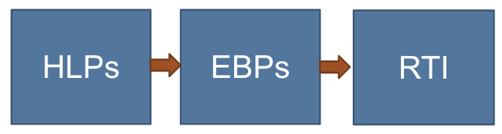
Guiding Questions
What are evidence-based practices and high leverage practices within RTI?
What is the relationship among the three terms?
Notes:
In this section, we discuss the instructional components necessary for MTSS which lead to improved student outcomes. In particular, we will discuss how high leverage practices are necessary to deliver evidence-based practices within RTI.
Trainer Notes: Ensure all participants have a clear understanding of the key terms.
HLP – High leverage practices are how educators deliver instruction (high yield strategies, effective instruction practices)
EBP – evidence-based practices
MTSS – multi-tiered system of support

Slide 14
High Leverage Practices
“A set of practices that are fundamental to support…student learning, and that can be taught, learned, and implemented by those entering the profession.”
(Windschitl, Thompson, Braaten, & Stroupe, 2012, p. 880)
HLPs are HOW teachers deliver instruction. All teachers should have deep knowledge in a core set of effective instructional practices.
(McLeskey & Brownell, 2015)
Notes:
A “high-leverage practice” is an action or task central to teaching. Carried out skillfully, these practices increase the likelihood that teaching will be effective for students’ learning. They are useful across a broad range of subject areas, grade levels, and teaching contexts, and are helpful in using and managing differences among students. The set of high-leverage practices is intended as a common framework for teaching that will provide a core “curriculum” for an educator preparation program. (McLeskey & Brownell, 2015)
In other words, HLPs are what make teachers ‘teachers’.

Slide 15
High Leverage Practices
HLPs are applicable to the everyday work of teachers
Fundamental to effective teaching across the tiers
Cut across content domains and grade levels
Used frequently
Supported by research
Notes:
High-leverage practices (HLPs) are considered the basic fundamentals of teaching. These practices are used constantly, are critical to helping students learn important content, and are also central to supporting students’ social and emotional development. HLPs are used across a broad range of subject areas, grade levels, and teaching contexts.
All teachers should have deep knowledge in a core set of effective instructional practices. A “high-leverage practice” is an action or task central to teaching and are helpful in managing differences among students. Carried out skillfully, these practices increase the likelihood that teaching will be effective for students’ learning.
HLPs are not constrained by content or grade level. HLPs are cross-cutting practices that are used by all teachers in delivering evidence based practices. HLPs are about how teachers deliver instruction, including evidence-based practices (McLeskey & Brownell, 2015).
HLPs are…
Fundamental to effective teaching across the tiers
Observable; they can be operationalized, taught, mastered, measured, and used frequently
Sufficient grain size to preserve complexity of teaching
Essential for implementing evidence-based practices

Slide 16
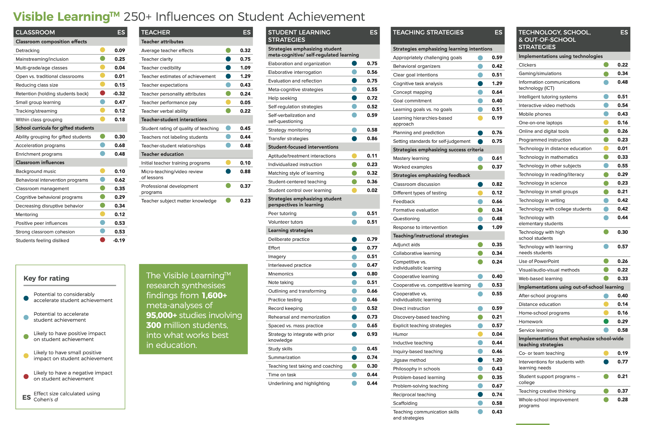
Notes:
In 2009, John Hattie published Visible Learning: A Synthesis of Over 800 Meta-Analyses Relating to Achievement. This aggregated the findings from 800 meta-analysis of 50,000 research studies, involving more that 150 million students, into what works best in improving student learning outcomes.
Since then, Hattie has continued to collect and aggregate meta-analyses to the Visible Learning database. His latest dataset synthesises 1,400 meta-analyses of 80,000 studies, involving more than 300 million students to create 250+ Influences on Student Achievement.

Slide 17
High Leverage Practices
Accelerate Student Achievement
High Leverage Practice | Effective Size if Used With Fidelity
Explicit Instruction | 0.57
Scaffolded Supports | 0.58
Identify and Prioritizing Learning Goals | 0.51-0.59
Feedback | 0.66
Response to Intervention | 1.09
Strategies to Promote Active Student Engagement | 0.40-1.20
Teaching Cognitive and Metacognitive Strategies | 0.55-1.29
Notes:
When used with fidelity, these high leverage practices are shown to have the highest effect size on student achievement.

Slide 18

High Leverage Practices
Expert Activity
Read about the assigned high-leverage practice(s).
Prepare two to three key points and an implementation consideration related to your HLP(s) to share with the larger group.
Workbook
Activity
Notes:
Trainer Notes: Refer participants to the Participant Workbook, Activity 1: High-Leverage Practices. Review the activity directions. Provide 25 – 35 minutes for this activity.
Expert Activity:
Place participants into groups of 4-5.
Divide the 22 practices among the group members. Team members can number off or assign chunks of practices.
Provide individual team members 5-7 minutes to review the assigned practices and take notes on the Activity 1: Expert Note-taking Guide.
Individual team members briefly describe the assigned practices with the group (~1 minute per practice).
Discuss implementation considerations.

Slide 19
What are Evidenced-Based Practices?
EBPs are taught using HLPs!
Are content specific
Developmentally appropriate
Learner dependent
Supported by research
Notes:
EBPs and HLPs are similar in that they are both grounded in strong research, however both have some distinct differences. (read slide)
HLPs are how evidence-based practices are delivered.

Slide 20
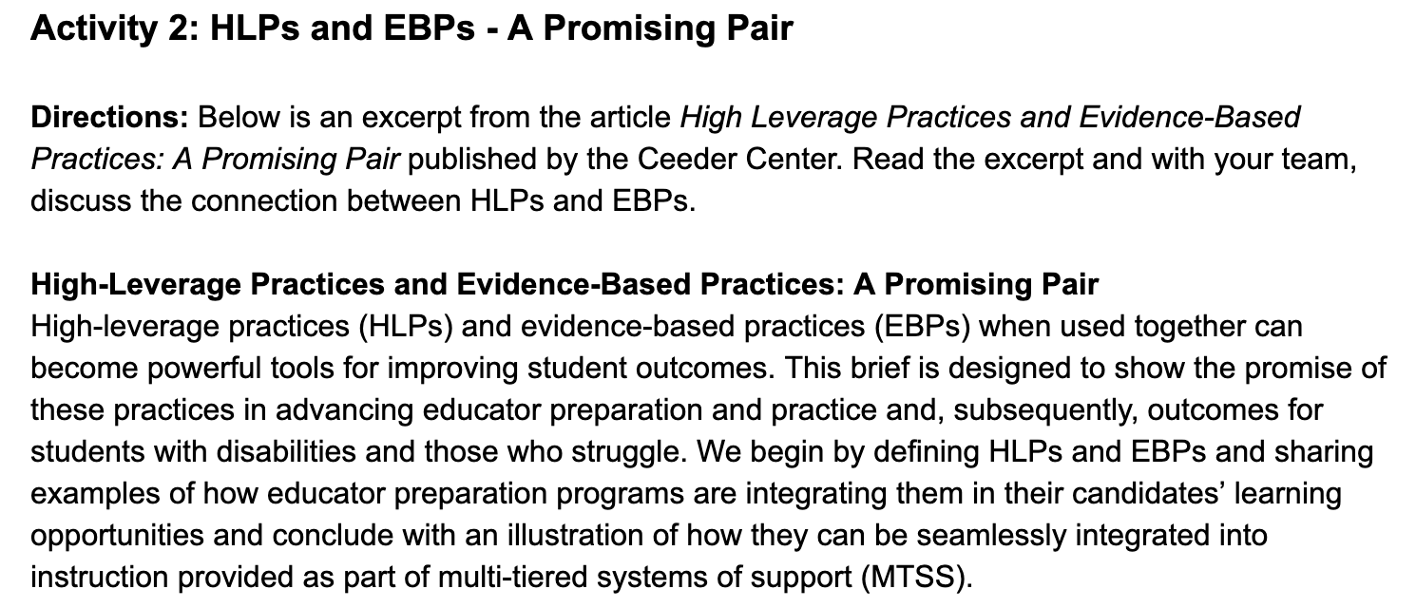
HLPs and EBPs: A Promising Pair
Workbook
Activity
Notes:
Trainer Notes: Direct participants to Activity 2: HLPs and EBPs - A Promising Pair in the Participant Workbook. Review the directions. After teams discuss the connection between HLPs and EBPs, share out whole group.

Slide 21
Across the Tiers
 | Tier I | Tier II | Tier III
Instruction/ Intervention Approach | Comprehensive, research-based curriculum and differentiated based on students’ needs | Supplemental, evidence-based interventions; supports core instruction | Supplemental, customized, intensive, systematic, evidence-based instruction that targets areas of greatest need; supplements core instruction
Group Size | Whole group with flexible grouping | Small, homogeneous grouping (1:3-1:5) | Small, homogeneous grouping (1:1-1:3)
Assessment | Screening, 3 times yearly | Biweekly | Weekly
Population Served | All students | Students identified as at risk (10%–15%) | Significant and persistent learning needs, nonresponders (1%–5%)
Discuss
Notes:
Trainer Notes: Direct participants to Activity 2: HLPs and EBPs - A Promising Pair in the Participant Workbook. Review the directions. After teams discuss the connection between HLPs and EBPs, share out whole group.

Slide 22
Multi-Tiered System of Supports: Core Instruction

Slide 23
Why Do We Need a
Prevention Framework?
Student Outcome | Early Elementary K–3 |  | Upper Grades 4–9
 | Mean ES | No. of Effects | Mean ES | No. of Effects
Comprehension | .46 | 25 | .09 | 37
Reading Fluency | .34 | 11 | .12 | 8
Word Reading | .56 | 53 | .20 | 22
Spelling | .40 | 24 | .20 | 5
Wanzek et al., 2013
Notes:
Trainer Notes: Mean Effect Sizes (ES) for Students With Reading Difficulties Provided Intensive Interventions. A meta-analysis of extensive interventions (75 or more sessions not part of the general curriculum) found positive results for students with learning disabilities or reading difficulties, with stronger effect sizes for early elementary.
Our ability to effectively intervene decreases over time.
As you will notice, the effects of literacy interventions greatly diminishes as students move up in grades. Does this mean we don’t provide reading intervention? No, what it means is that standardized reading interventions alone are not sufficient to close achievement gaps for students. This is why the focus of interventions at the secondary level tend to be more individualized.

Slide 24
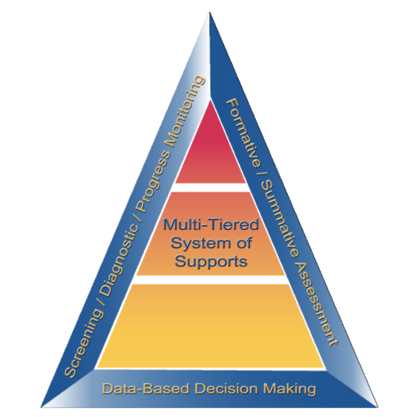
Essential Components of RTI
Notes:
While elementary RTI models are not appropriate for most secondary setting, the essential components of an RTI model at the elementary and secondary level are the same.
The Division of Elementary and Secondary Education (DESE) has developed this graphic to highlight the essential components of the RTI framework found in both elementary and secondary models. The blue sections include an assessment framework for the pyramid which includes screening, progress monitoring, formative and summative assessments. These assessments guide our instruction throughout the multi-tiered system of support. The entire framework rests on data-based decision making which integrates assessments and instruction. In the middle of the graphic lies the pyramid or multi-level system of support that many associate with RTI.

Slide 25
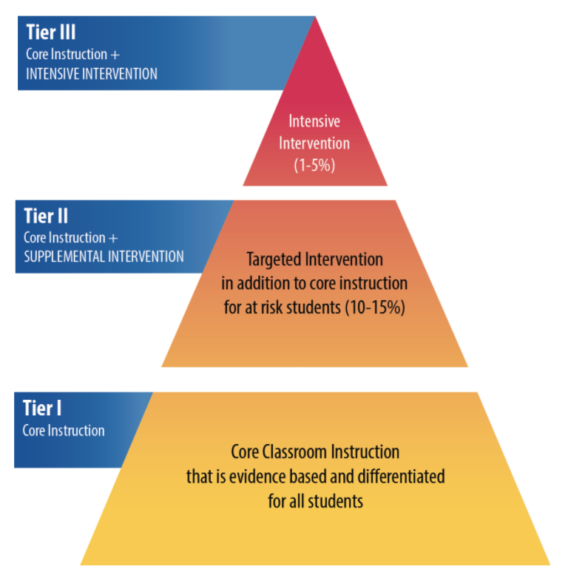
RTI Arkansas Model
Notes:
The pyramid graphic depicts the progression of support across the multilevel prevention system. It represents three tiers of prevention and the percentage of students we would expect to benefit from those levels of prevention in an effective system.
The first tier is the base of the pyramid as it is the foundation of the framework. In Arkansas, we expect most students, at least 80%, to benefit from the instruction, which uses well-differentiated instruction in the core curriculum. The next tier, Tier 2, is the second level. We expect approximately 10–15% of students to need supplemental, small-group instruction to benefit from the core instruction and curriculum. The top level in red, or Tier 3 Intensive Intervention, includes specialized, individualized instruction for students with intensive needs. It typically involves small-group and/or one-on-one instruction of one to three students who are significantly behind their peers. Decisions regarding student participation in both Tier 2 and Tier 3 interventions are made on a case-by-case basis according to student need.
Trainer Notes: It is important to differentiate between an RTI framework and an RTI model. The levels correspond to the RTI framework, whereas the tiers correspond to the RTI model specified by states, districts, and schools. Keep in mind that these are recommended estimates.

Slide 26

Purpose of Tier 1 Core Instruction
Serves as the foundation of the RTI framework
Meets the needs of ALL students
Provides ALL students will high quality instruction
Increases access to quality Tier I instruction through differentiated instruction
Core instruction is the first line of defense against academic failure.
Notes:
Tier I: Core Instruction is what all teachers are doing each day with students to expose them to grade-level content and materials. Tier I is critical to a successful RTI framework as it lays the foundation for the system. If most students are not getting the instruction that they need in the general education classroom, they fall behind and become closer to achieving at-risk status.
The focus of Tier 1 instruction is all students, including those with disabilities, learning differences, or language barriers, having access to quality core instruction.
Effective core instruction includes differentiated instructional strategies. Through differentiation, teachers are able to assess students’ current understanding through formative assessments and differentiate their instruction to meet the learning needs of all students. Differentiated instruction allows teachers to address skill gaps that students may have in a particular areas immediately. High school teachers also have the flexibility to work with a group of students on specific skills based on formative assessments, this type of support is still part of Tier I instruction. You can increase access for all students through differentiated instruction, linguistically and culturally responsive practices, and using accommodations or modifications within your school.
It is important for students receiving Tier II or Tier III intervention to also continue to receive high-quality Tier I core instruction.

Slide 27
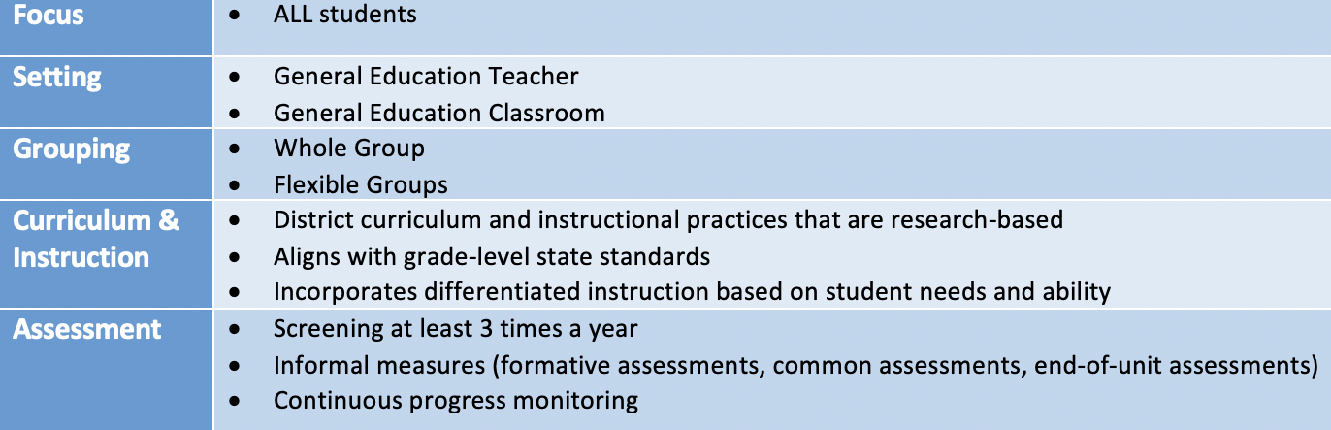
Tier I Characteristics
The focus is on prevention for all students.
Notes:
The focus of Tier I is on prevention for all students. Instruction is delivered within the general education classroom and can include flexible grouping formats. Instruction at Tier I lasts all year.
The district’s core curriculum and instructional practices are research-based, aligned with grade-level state standards, and differentiated based on student need and ability. Differentiated instruction allows teachers to immediately address skill gaps that students may have in a particular area.
Universal screening should be conducted three times per year (fall, winter, and spring) and conducted in combination with informal measures (formative and summative assessments). Screening and informal measures are administered to inform instruction and identify students who may be at-risk. Progress monitoring assessments allow us to gauge student progress.

Slide 28
Tier I Critical Features
Design
Uses research-based curriculum materials
Articulation of teaching and learning (in and across grade levels)
Curriculum aligned to state standards
Schedule
Delivery
Evidence-based practices and high leverage practices
Consistent use of differentiated instruction
Inclusion of students with disabilities and those exceeding benchmark
Notes:
As we talk about Tier I, we are referring to the alignment of core instruction and expectations for both behavior and academics.
Read the slide.

Slide 29
Poor Quality of Tier 1 Impact
Increase in the number of students in intervention
Decrease in impact of interventions and instruction
Fuchs & Fuchs, 2017
Discuss
Notes:
Trainer Notes: Ask participants to reflect on the slide content. Discuss the impact on students if Tier 1 core instruction is of poor quality.

Slide 30
Indicators of Tier 1 Concerns
Less than 80% of students are identified as at or above grade level expectations or identified measures
Inconsistent performance across classrooms, grades, or schools
Poor attendance, low student engagement, and/or frequent behavior problems
High rates of students (>20%) identified for supplemental support
Differential benefit across student populations
Low teacher satisfaction or engagement
Notes:
Read the slide.

Slide 31
Key Characteristics of
High Quality Tier 1 Instruction
Consistent opportunities to work on grade-appropriate assignments
Strong core instruction where students do most of the thinking in a lesson
Deep engagement in what students are learning
Teachers who hold high expectations for students and believe they can meet grade level standards
TNTP, Inc. 2018

Slide 32
Effective Instruction
“It is imperative to equip teachers with a set of practices that are supported by research evidence to have significant potential for improving academic or behavioral outcomes for students with disabilities.”
High Leverage Practices for Inclusive Classroom, CEC 2019.
Notes:
We have a collective responsibility for student learning, and must provide the support needed to enable all students to be successful in the general education core content.
Collective Teacher Efficacy is the collective belief of teachers in their ability to positively affect students. With an effect size of d=1.57 Collective Teacher Efficacy is strongly correlated with student achievement.

Slide 33

High Leverage Practices
Set of practices that:
Support student learning
Can be taught, learned, and implemented
Applicable to the everyday work of teachers:
Used in classrooms to leverage and improve student outcomes
Used frequently by teachers
Broadly applicable across content areas
Fundamental to effective teaching
Notes:
As stated earlier, all teachers should have deep knowledge in a core set of effective instructional practices. Carried out skillfully, these practices increase the likelihood that teaching will be effective for students’ learning.
HLPs are not constrained by content or grade level. HLPs are cross-cutting practices that are used by all teachers in delivering evidence based practices. HLPs are about how teachers deliver instruction, including evidence-based practices (McLeskey & Brownell, 2015).
HLPs are… Read the slide.

Slide 34
Tier 1 Adolescent Literacy Practices
# | Recommendations | Evidence
1 | Provide explicit vocabulary instruction. | Strong
2 | Provide direct and explicit comprehension strategy instruction. | Strong
3 | Provide opportunities for extended discussion of text meaning and interpretation. | Moderate
4 | Increase student motivation and engagement in literacy learning. | Moderate
Notes:
These are example of evidenced-based practices in adolescent literacy. Note that these are not interventions but are practices that are components of an intervention.

Slide 35
Tier 1: 4th-8th Math
Instructional Practices
# | Recommendations | Evidence
1 | Prepare problems and use them in whole-class instruction. | Minimal
2 | Assist students in monitoring and reflecting on the problem-solving process. | Strong
3 | Teach students how to use visual representations. | Strong
4 | Expose students to multiple problem-solving strategies. | Moderate
5 | Help students recognize and articulate mathematical concepts and notation. | Moderate
(Woodward, Beckmann, Driscoll, et al., 2018)
Notes:
Sample practices in middle school math instruction. Note that there is minimal evidence for the first practice but it is included in the recommendations. Why? While there is not rigorous research, there is evidence that this practices leads to increased learning for students.

Slide 36
Secondary Core Tier 1
EBPs: School Completion
# | Recommendations | Evidence
1 | Monitor the progress of all students, and proactively intervene when students show early signs of attendance, behavior, or academic problems. | Minimal
2 | Provide intensive, individualized support to students who have fallen off track and face significant challenges to success. | Moderate
3 | Engage students by offering curricula and programs that connect schoolwork with college and career success and that improve students’ capacity to manage challenges in and out of school. | Strong
4 | For schools with many at-risk students, create small, personalized communities to facilitate monitoring and support. | Moderate
(Rumberger, R., Addis, H., Allensworth, E., et al., 2017).
Notes:
Recommendations and evidence for supporting students in completing high school.

Slide 37




Identifying Tier 1
Evidence-Based Practices
Notes:
Trainer Notes: A practice guide is a publication that presents recommendations for educators to address challenges in their classrooms and schools. They are based on reviews of research, the experiences of practitioners, and the expert opinions of a panel of nationally recognized experts.
For a full list of IES Practice Guides visit: https://ies.ed.gov/ncee/wwc/PracticeGuides

Slide 38
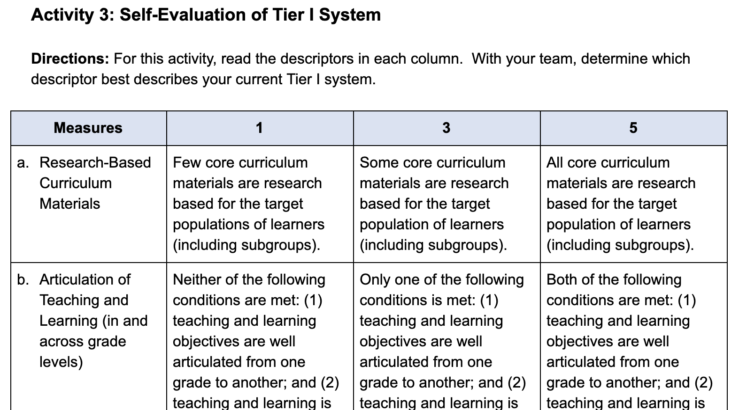
Tier I: Self-Evaluation
Workbook
Activity
Notes:
Trainer Notes: Refer participants to the Participant Workbook, Activity 3: Self-Evaluation of Tier I System. Briefly describe each component by reviewing the contents in the last column of the handout. Teams will conduct the self-evaluation activity as indicated in the directions. Provide teams approximately 5 - 7 minutes to reflect on which descriptor best describes their current Tier I system. Teams will use the self-evaluation results at the end of the module to create next steps around Tier 1 Core Instruction.

Slide 39
Multi-Tiered System of Supports: Supplemental and Intensive Intervention

Slide 40
Supplemental and
Intensive Instruction Focus
Students identified through screening as at risk for
poor learning outcomes; verified by progress monitoring
or other data
Typically, 15 percent to 20 percent of entire school population
At the high school level, a problem-solving approach should be used if the failure rate in any course, especially core courses, is greater than 10 percent
Notes:
The focus for supplemental instruction is on students identified through screening as at risk for poor learning outcomes. This is typically between 15-20 percent of the entire population. A school or district’s target identification rate may mean that not all students who meet the selection criteria for secondary prevention receive this level of support. If a large group of students are needing support in an area, core instruction needs to be examined and instruction adjusted to meet the group.

Slide 41

Tier II Supplemental Intervention
FOCUS | INTERVENTIONIST | CURRICULUM | GROUPING/ SETTING
Who receives instruction? | Who provides instruction? | What instructional materials are used? | How is instruction delivered?
Students not adequately responding to Tier 1: core instruction | General education teacher or other trained professional | Evidence- based tools that address identified area(s) of need | In small groups of 3–5 studentsª In targeted, homogenous groups determined by skill
Note. All interventions should be delivered with adherence to program developer guidelines.
ª Although research recommends small groups of 3–5 students, the intervention program should dictate the group size.
Notes:
At Tier II, supplemental intervention includes evidence-based intervention(s) of moderate intensity that address the learning challenges of most at-risk students.
Evidence-based means the programs or strategies have a research bank of support behind them – programs have been rigorously validated to show that they have a positive effect on student outcomes in the areas in which it was studied (e.g. fluency, comprehension, etc.).
Tier II typically occurs in a general education classroom or another general education location within the school. Supplemental instruction is provided in addition to the core curriculum, students should not miss general education instruction. Supplemental intervention relies entirely on adult-led small-group instruction rather than whole-class instruction and involves instruction where the group size is optimal for the age and needs of the students.
Differentiated instruction or remediation at Tier 1 is not the same as providing Tier 2 intervention.

Slide 42

Four Critical Features of Tier 2
Uses evidence-based interventions that support academic and behavior needs
Complements core instruction/program
Uses standardized interventions with appropriate dosage and grouping size delivered by trained personnel with fidelity
Scheduled in addition to Tier 1
Notes:
All Tier II interventions are evidence-based in content areas and grade levels where available and support academic and behavior needs.
Tier II complements core instruction; specifically, it is well aligned with core instruction and incorporates foundational skills that support the learning objectives of core academic instruction and supports behavior programs.
The third critical feature pertains to the use of instructional characteristics. Specifically, all three of the following conditions are met: (1) interventions are standardized; (2) Tier II level interventions are led by educators trained in the intervention; and (3) group size and dosage are optimal (according to research) for the age and needs of students.
The fourth critical feature is that Tier II level interventions supplement core instruction. They should be scheduled in addition to Tier I.
Trainer Notes: Invite participants to discuss how they approach scheduling Tier II interventions in addition to Tier I.
CC Image from Pixabay.com

Slide 43
Tier 3: Intensive Intervention
Intensive intervention is designed to address severe and persistent learning or behavioral difficulties
Driven by data
Characterized by increased intensity (e.g., smaller group, expanded time)
Provided with individualized academic instruction and/or behavioral supports
Notes:
Read the slide.
If Tier 2 interventions are insufficient, each feature of the intervention is intensified to provide Tier 3 or intensive intervention. The main distinction between the two is that Tier 2 intervention components are generally standardized, while intensive intervention components are more individualized.

Slide 44
Who Needs Intensive Intervention?
Students with very low academic achievement and/or high-intensity or high-frequency behavior problems (may be with disabilities)
Students in a tiered intervention program who have not responded to Tier 2 intervention(s) delivered with fidelity
Students with disabilities who are not making adequate progress in their current instructional program
Notes:
The decision to move a student directly to an intensive intervention should be made on an individual and case-by-case basis. In most cases, data should be collected over time to help demonstrate that the student’s low achievement/behavior challenges are both significant AND persistent. This can include students who have received Tier 3 interventions in previous grades.

Slide 45
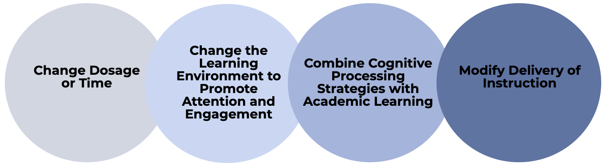
Essential Tier 3 Criteria
More intensive than Tier 2 intervention(s)
Adapted to address individual student needs in a number of ways (e.g., increased duration or frequency, change in interventionist, decreased group size, change in instructional delivery, and change in type of intervention)
A consistent process based on student data
Notes:
Read the slide.

Slide 46
Essential Tier 3 Criteria
Led by well-trained staff, experienced in individualizing instruction based on student data
Students can be identified for Tier 3 supports either through universal screeners or nonresponse to an evidence-based intervention
The advantage of using a universal screener is that students do not have to wait to fail at Tiers 1 and 2
Notes:
Read the slide.

Slide 47
Key Considerations: Evidence-Based Interventions
Does evidence suggest the intervention is expected to lead to improved outcomes (strength)?
Will the group size, duration, and frequency provide sufficient opportunities to respond (dosage)?
Does the intervention match to the student’s identified needs (alignment)?
Does it assist the student in generalizing the learned skills to general education or other tasks (attention to transfer)?
Notes:
Read the slide.

Slide 48
Key Considerations: Evidence-Based Interventions
Does the intervention include elements of explicit instruction (comprehensiveness)?
Does the student have opportunities to develop the behavior skills necessary to be successful (behavioral support)?
Notes:
Read the slide.

Slide 49
Fidelity of Implementation

Slide 50
Fidelity & Your RTI Framework
Fidelity
Multi-Tiered System of Supports
Data-Based Decision Making
Screening/
Diagnostic/
Progress Monitoring
Formative/
Summative Assessment
National Center on Response to Intervention, 2012
Notes:
Fidelity does not touch just one or two aspects of RTI—it is a thread that runs through all the components of RTI. Fidelity checks are predetermined and regularly applied to ensure that RTI practices are integrated and sustain the RTI framework.
Fidelity is important when we are providing instruction and interventions at Tier 1, Tier 2, and Tier 3—ensuring that we are implementing the instruction or interventions consistently and as intended (as specified by program requirements).
Fidelity is important as we screen for students at risk: a valid and reliable screening tool should be administered at appropriate intervals throughout the year.
The same is true for progress monitoring. We want to make sure that school staff members who monitor student progress use the progress monitoring tools the right way and interpret the data correctly. We also want to make sure the tool is valid and reliable.
Data-based decision making should be implemented as intended. Decision rules that have been carefully determined and put in place should be followed.

Slide 51
What is Fidelity of Implementation?
Delivery of instruction in the way in which it was designed
Quality of implementation
Degree to which the selected scientifically-based interventions are supported by data
Accuracy
Consistency
Integrity
Fidelity
Notes:
Read the slide.
Why is Fidelity of Implementation Important?
Fidelity of implementation is critical if RTI is to be successful. For an RTI component to be successful in addressing current challenges, that component needs to be implemented with high integrity. When schools adopt new initiatives, curriculums, or assessments in name only, without fidelity to essential program design features, results are often poor. Several studies confirm the importance of fidelity of implementation to maximize program effectiveness. Although these studies examined various interventions, the results suggest that positive student outcomes may be attributed to three related factors:
Fidelity of implementation of the process (at the school level).
Degree the selected scientifically-based interventions are supported by data.
Fidelity of intervention implementation (at the teacher level).
If we are implementing RTI with fidelity, we are using our curriculum and instructional and assessment practices in the same way over time, throughout the day, and across lessons, and as they were intended to be used. In other words, we are using the practices (curriculum and instructional/assessment practices) with consistency and accuracy. It is also important to point out that you may often see fidelity used interchangeably with integrity.

Slide 52
Why is Fidelity Important?
Ensures that instruction has been implemented as intended
Allows us to link student outcomes to instruction
Helps in the determination of intervention effectiveness and instructional decision-making
Positive student outcomes depend on level of fidelity of intervention implementation
Evidence-
Based Practices
Implementation Fidelity
Improved Student Outcomes
Pierangelo & Giuliani, 2008
Notes:
Why is fidelity important? If teachers aren't consistent and accurate in delivering Tier II interventions, they aren’t able to confidently explain a student's lack of response to an intervention. Did the student make insufficient progress because they require more intensive intervention? Or, did the student make insufficient progress because the Tier II intervention wasn’t delivered with fidelity? Without practicing consistency and integrity in intervention delivery, we can't link, or attribute, student outcomes to the instruction provided. Fidelity allows us to evaluate the effectiveness of the Tier II intervention and tells us when a student may require a more intensive level of intervention.
Furthermore, Pierangelo and Giuliani (2008) concluded that positive student outcomes are particularly dependent on aspects of fidelity within the framework of a tiered support system. One of these aspects is fidelity of implementation at the classroom or teacher level.

Slide 53
Fidelity of Implementation
Tier 2
Tier 3
Degree to which the program is implemented the way it was intended by the program developer
Degree to which the program is implemented the way it was designed or adapted based on data and fidelity to the Tier 3 data decision-making process
(Gersten et al., 2005; Mellard & Johnson, 2007; Sanetti & Kratochwill, 2009)
Notes:
Fidelity refers to how closely prescribed procedures are followed, and in the context of schools, the degree to which teachers implement programs the way they were intended by the program developers. It also relates to the quality of the implementation.
In most cases, we want to give students the chance to respond to Tier 2 interventions implemented with fidelity, before we determine the need for intensive, individualized interventions.
However, when students do not respond as expected, a change is needed. With Tier 3, educators will use data to make changes to the implementation of the intervention to increase the impact on student performance. Educators will need to maintain fidelity to the adaptation to assess the impact of the change and determine if the adaptation was effective.

Slide 54
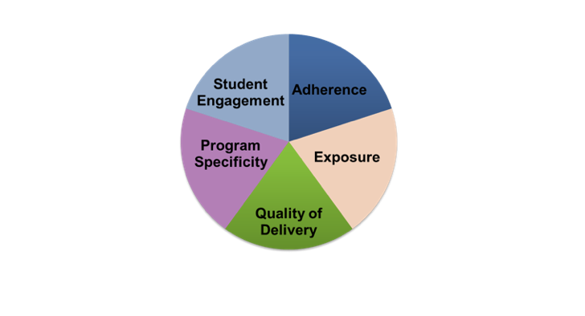
Five Elements of Fidelity
Student Engagement: How engaged and involved are the students in this intervention or activity?
Adherence:
How well do we stick to the plan/curriculum/assessment?
Program Specificity:
How well is the intervention defined and different from other interventions?
Exposure/Duration:
How often does a student receive an intervention? How long does an intervention last?
Quality of Delivery:
How well is the intervention, assessment, or instruction delivered? Do you use good teaching practices?
Dane & Schneider, 1998; Gresham et al., 1993; O’Donnell, 2008
Workbook
Activity
Notes:
Trainer Notes: Refer participants to the Participant Workbook, Activity 4: Five Elements of Fidelity. After reviewing each element, have teams answer the questions to complete the chart.
This slide provides a more in-depth look at the components of fidelity often discussed in literature (Dane & Schneider, 1998; Gresham et al., 1993; O’Donnell, 2008). While the elements or components of fidelity and their organization may vary, this provides one example of a way to think about fidelity. The slide includes five elements of fidelity- adherence, exposure, quality of delivery, program specificity, and student engagement.
Adherence is focused on how well we stick to the plan/curriculum/assessment—do we implement as the plan/curriculum/assessment was intended to be implemented based on research?
Exposure/duration refers to how often a student receives an intervention and how long an intervention lasts. When thinking about fidelity we are considering whether the exposure/duration being used with a student matches the recommendation by the author/publisher of the curriculum.
Not only is it important to adhere to the plan/curriculum/assessment, it is also important to look at the quality of delivery. This refers to how well the intervention, assessment, or instruction is delivered. For example, do you use good teaching practices?
Another component is program specificity or how well the intervention is defined and different from other interventions. Having clearly defined interventions/assessments allows teachers to more easily adhere to the program as defined.
Just as quality of delivery is important, it is important to also focus on student engagement or how engaged and involved the students are in the intervention or activity. Following a prescribed program alone is not enough.

Slide 55
Tools to Assess Fidelity
Effective Coaching of Teachers: Fidelity Tool Worksheet
http://www.intensiveintervention.org/resource/effective-coaching-teachers-fidelity-tool-worksheet
Adherence to Essential Ingredients
Quality
Fidelity
Dose (Frequency and Duration)
Participant Responsiveness
Notes:
The Effective Coaching of Teachers: Fidelity Tool worksheet and rubric can be used to collect and score information about the fidelity of coaching. The collected information can be used by coaches and other educators to continuously improve upon how coaching occurs.

Slide 56
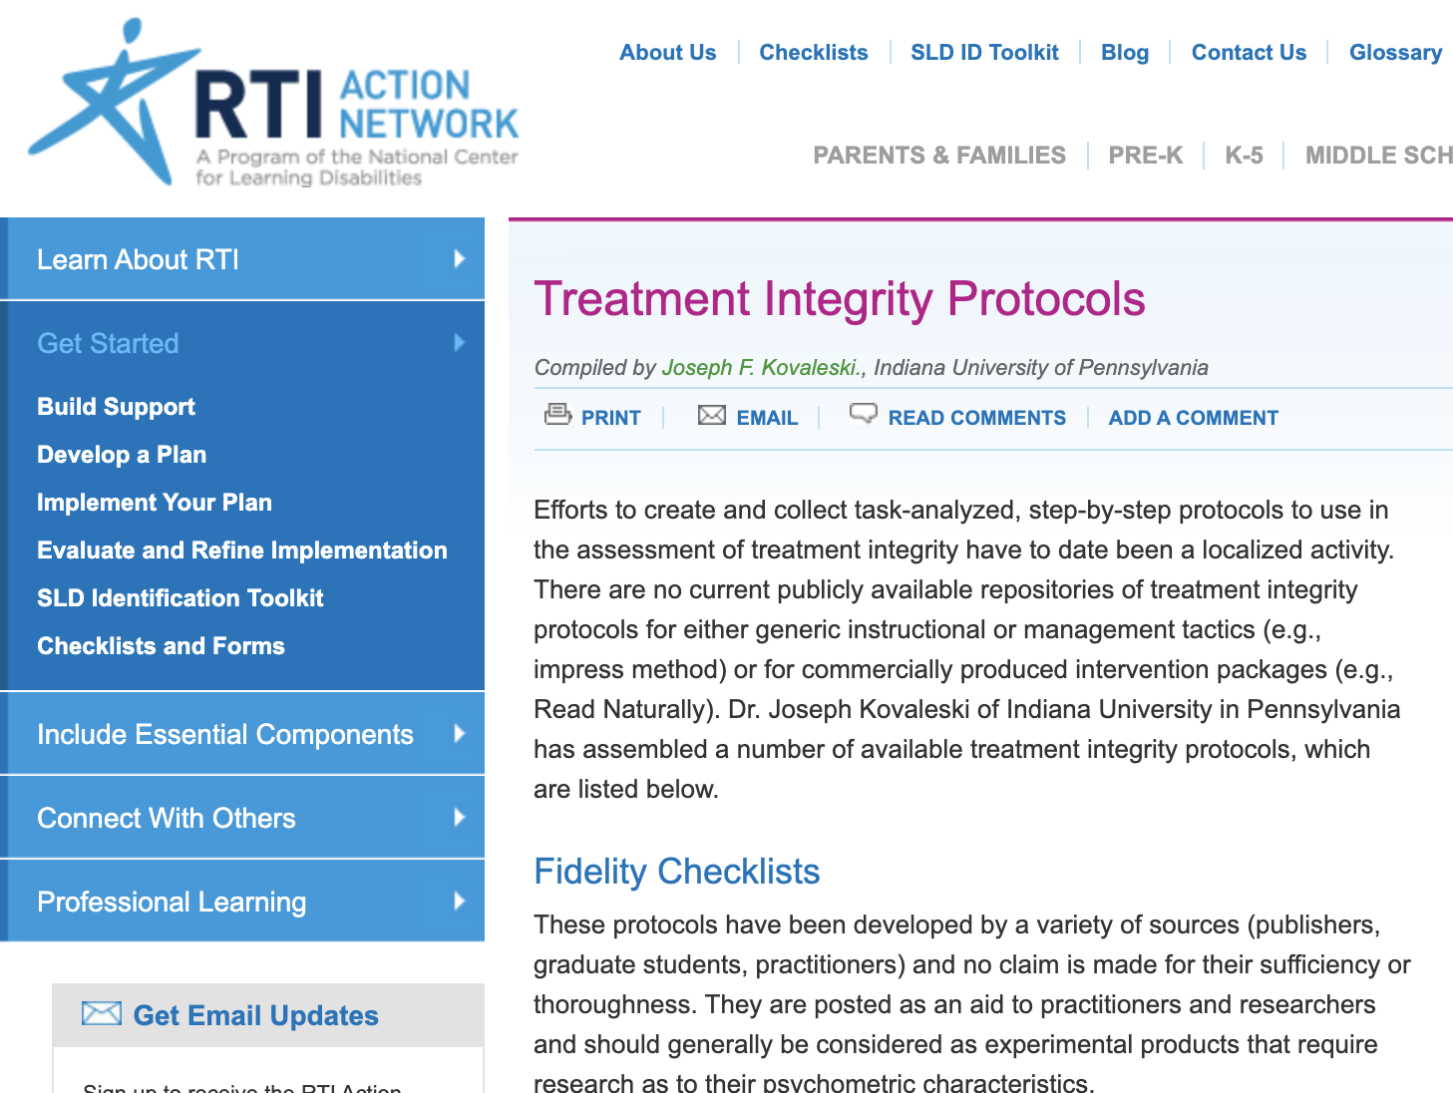
Monitoring Implementation
Fidelity Checklist Resource
Notes:
There are many examples of fidelity tools that teams could consider. This resource is from the RTI Action Network. There are several protocols on this website.
http://www.rtinetwork.org/getstarted/evaluate/treatment-integrity-protocols

Slide 57
Closing and Next Steps

Slide 58
Disclaimer
There is not a single evidence-based practice or intervention that works for every student.

Slide 59
Team Action Planning
Considerations:
  What are your goals for implementing HLPs and EBPs in the upcoming school year?
  How will your team use the Tier 1 Self-Reflection data to strengthen core instruction?
  What support do you need to effectively implement HLPs and EBPs?
Workbook
Activity
Notes:
Trainer Notes: Direct teams to the action plan located at the end of the Participant Workbook. Teams will have 30-45 minutes to begin action planning. If possible, provide opportunities for teams to share with other teams for feedback.

Slide 60
Resources to Support Implementation of EBPs and HLPs
  Center on Response to Intervention
  www.rti4success.org
  National Center on Intensive Intervention
  www.intensiveintervention.org
CEEDAR Center
http://ceedar.education.ufl.edu/
Notes:
Several websites are listed here with resources that you can download, as well as videos and webinars related to MTSS.
If time allows, provide brief tours of these websites.

Slide 61
Evidence-Based Practices Resources
What Works Clearinghouse
http://ies.ed.gov/ncee/wwc/findwhatworks.aspx
NCII Interventions Tools Chart
http://www.intensiveintervention.org/chart/instructional-intervention-tools
Best Evidence Encyclopedia
http://www.bestevidence.org/
Notes:
There are a number of resources to support schools in identifying evidence-base practices and interventions. The What Works Clearinghouse is probably the most useful for secondary settings because of the grade spans it covers. It also covers broader topics relevant to secondary settings, like school completion and school climate, that are important for effective schools. The other two resources may be useful for teams as they move to select and evaluate specific academic and behavior intervention resources.

Slide 62
References
Kamil, M. L., Borman, G. D., Dole, J., Kral, C. C., Salinger, T., and Torgesen, J. (2008). Improving adolescent literacy: Effective classroom and intervention practices: A Practice Guide (NCEE #2008-4027). Washington, DC: National Center for Education Evaluation and Regional Assistance, Institute of Education Sciences, U.S. Department of Education. Retrieved from http://ies.ed.gov/ncee/wwc .
National Center on Response to Intervention. The essential components of RTI. Retrieved from www.rti4success.org
Woodward, J., Beckmann, S., Driscoll, M., Franke, M., Herzig, P., Jitendra, A., Koedinger, K. R., & Ogbuehi, P. (2012). Improving mathematical problem solving in grades 4 through 8: A practice guide (NCEE 2012-4055). Washington, DC: National Center for Education Evaluation and Regional Assistance, Institute of Education Sciences, U.S. Department of Education. Retrieved from http://ies.ed.gov/ncee/wwc/publications_reviews.aspx#pubsearch/.

