Slide 1
Federal Pre-K Program
Informational Meeting

Slide 2
Federal Pre-K Transition
As we approach the conclusion of the 2025–2026 school year, we would like to share an important update regarding program operations. The Federal Pre-K program will conclude at the end of the 2025–2026 school year.
Beginning with the 2026-2027 school year, the following transitions will occur for Federal Pre-K programs. Those who are:
Current ABC programs: current Federal Pre-K slots will transition to participation in the Arkansas Better Chance (ABC) Program.
Non-ABC programs: are encouraged to assist families in applying for School Readiness Assistance Program. OEC will work with these providers to ensure slot availability for the start of the school year.
The following FAQ addresses common questions and concerns regarding Federal Pre-K.
This FAQ only applies to programs who received correspondence directly from OEC regarding the cancellation of the Federal Pre-K program, and who participated in Federal Pre-K for the 25-26 school year.

Slide 3
FAQ - PROGRAMS TRANSITIONING FROM FEDERAL PRE-K TO ABC
1. Will all adults in the household be required to work?
a. No, if the child is in an ABC slot, there is not a work requirement. Eligibility requirements for ABC must be met.
2. How many children may be moved from Federal Pre-K to Arkansas Better Chance (ABC)?
a. There are 894 Federal Pre-K slots awarded to current ABC providers.
3. What will be the rate of pay?
a. ABC rates will apply for children transitioning from Federal Pre-K to ABC.
4. How many private providers will be impacted?
a. There is one privately owned ABC facility that will be transitioning slots from Federal Pre-K to ABC.
5. When do these changes to Federal Pre-K slots take effect?
a. Federal Pre-K will be paid through the end of the 25-26 school year.
6. How many Federal Pre-K programs will transition to ABC?
a. There are 30 entities currently participating in Federal Pre-K that may have the opportunity to transition these slots to ABC.

Slide 4
FAQ – Federal Pre-K Programs Transitioning to SRA
1. Will all adults in the household be required to work?
a. Yes, families applying for services in SRA must meet eligibility requirements.
2. What is going to be the rate of pay?
a. All children authorized in SRA are paid according to the current daily rate structure.
3. How many non-ABC, Federal Pre-K programs are affected?
a. Only 8 programs are non-ABC; of those 8, only one facility is privately owned. Non-ABC programs should encourage families to apply for services through the SRA Portal.
4. When do these changes to Federal Pre-K slots take effect?
a. Federal Pre-K will be paid through the end of the 25-26 school year.
5. Will children transitioning from Federal Pre-K to SRA be waitlisted?
a. Children currently served in Federal Pre-K will not be subject to the waitlist.

Slide 5
Arkansas Better Chance (ABC)

Slide 6
ABC Eligibility Criteria
Family with gross income not exceeding 200% of FPL. Program may utilize a sliding fee scale up to 250% of FPL.
Has a demonstrable developmental delay as identified through screening
Parents without a high school diploma or GED
Eligible for services under IDEA
Low birth weight (below 5 pounds, 9 ounces)
Income eligible for Title I programs
Parent was under 18 years of age at child’s birth
Limited English Proficiency
Immediate family member has a history of substance abuse/addiction
Parent has history of abuse of neglect
In Foster care at the time of enrollment
Has an incarcerated parent (must be within the lifetime of the child)
Is in the custody of/living with a family member other than mother or father
For a full list of program and family requirements, please review the ABC program guide.
Arkansas Better Chance (ABC) Program Guide

Slide 7
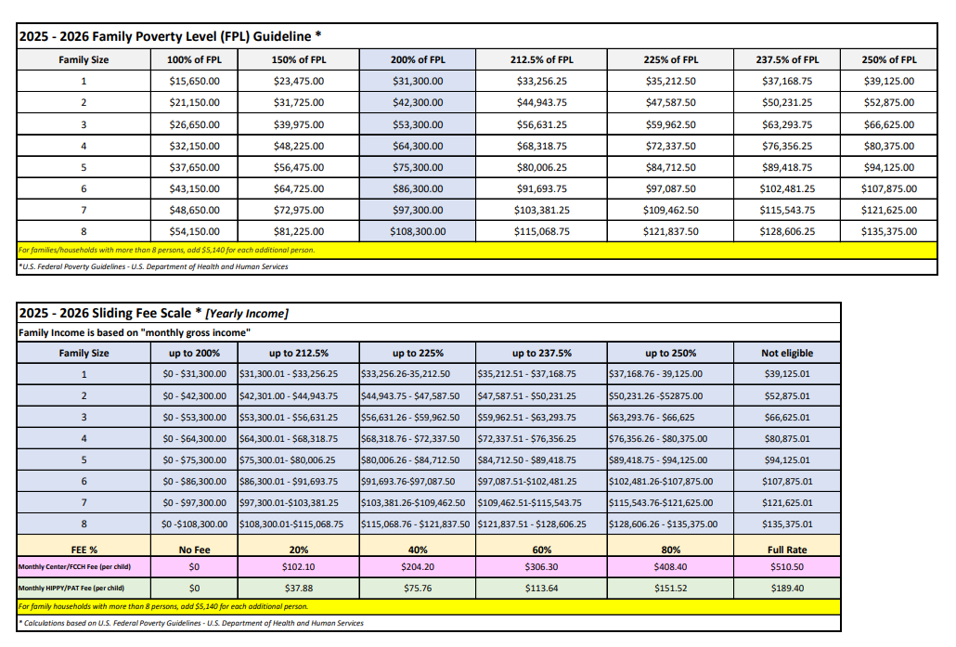
Arkansas Better Chance (ABC) Reimbursement
The reimbursement rate for Federal Pre-K is currently based on quality and age of the child. Programs transitioning to ABC will receive the ABC reimbursement. The current reimbursement rate per child is $510.50 per month, this is approximately $28 per day. The Income Guidelines are below:

Slide 8
School Readiness Assistance

Slide 9
SRA Eligibility Criteria
All adults in the Low-Income Eligibility group must:
Work thirty (30) or more hours per week or,
Attend school full time or job skills training program that equals thirty (30) or more hours per week or,
Combine work and school/job skills training program that equals thirty (30) or more hours per week.

Slide 10
SRA Eligibility Criteria (Cont.)
At least one adult in the Extended Support Services (ESS) group must:
In the first twelve (12) months:
Work at least twenty (20) or more hours per week, or your earnings must be enough to cause you to be ineligible for Transitional Employment Assistance (TEA) cash assistance.
Attend school full time or job skills training program that equals twenty (20) or more hours per week or,
Combine work and school/job skills training program that equals twenty (20) or more hours per week.
In the second twelve (12) months:
Work at least twenty- five (25) or more hours per week
Attend school full time or job skills training program that equals twenty-five (25) or more hours per week or,
Combine work and school/job skills training program that equals twenty-five (25) or more hours per week.

Slide 11
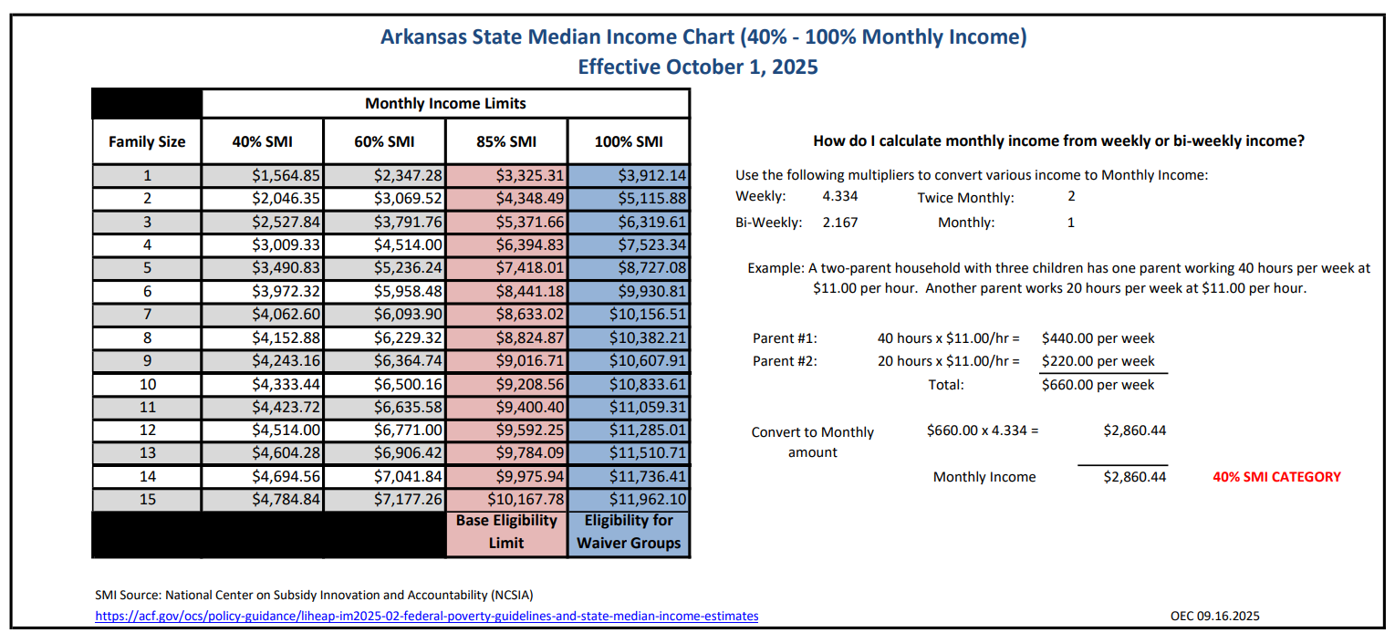
SRA Eligibility Criteria (Cont.)

Slide 12
School Readiness Assistance (SRA) Reimbursement
Information regarding the SRA program can be found on our website:
Division of Elementary and Secondary Education - Offices - Early Childhood - School Readiness Assistance Program.
Rate of pay will align with the daily rate structure implemented November 2025, with Casehead Daily Amounts assessed for applicable families.
SRA billing may include a Quality Enhancement Payment per child for eligible facilities.

Slide 13
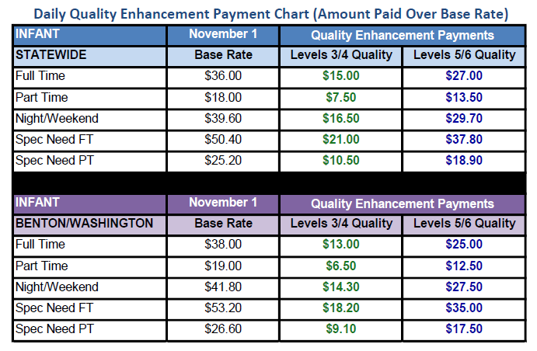
SRA Rate Structure Effective 11.1.25

Slide 14
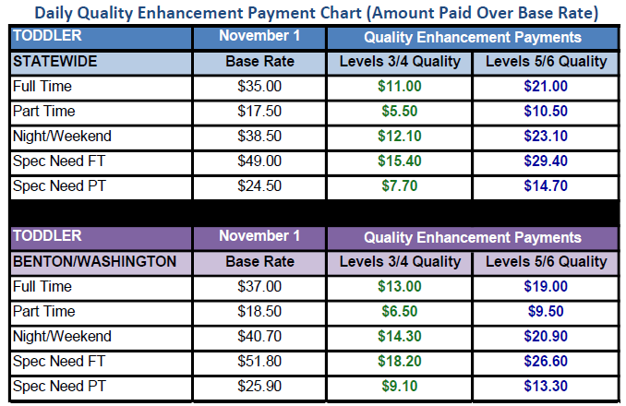
SRA Rate Structure Effective 11.1.25

Slide 15
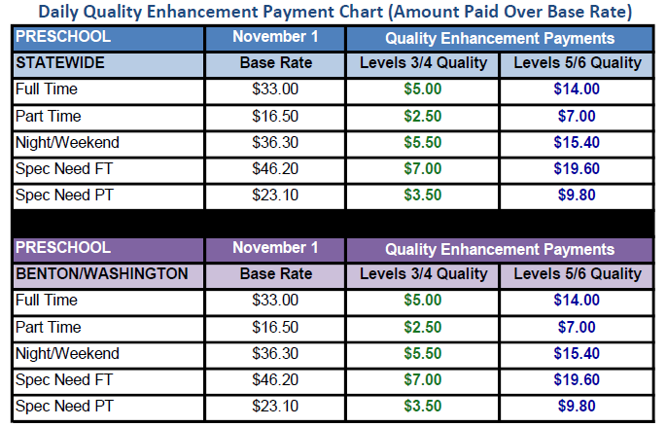
SRA Rate Structure Effective 11.1.25

Slide 16
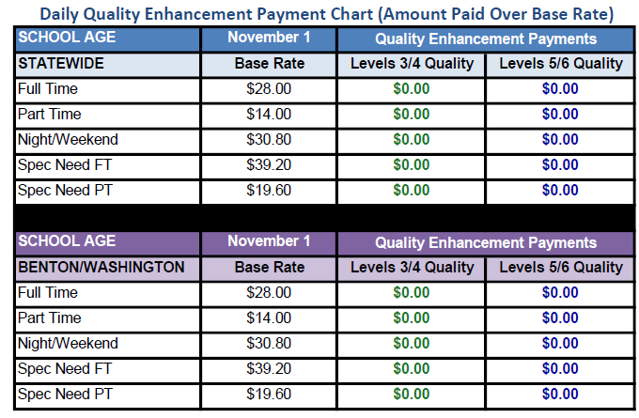
SRA Rate Structure Effective 11.1.25

Slide 17
Does this effect other funding?
This change is only for Federal Pre-K programs.

Slide 18
Programs will be notified soon regarding the availability of transitioning to ABC slots.
Notes:
Reminder, you cannot bill for children in SRA if they are in Summer ABC.

Slide 19
Contact Information
Federal Pre-K Email:
oec.FederalPreK@ade.arkansas.gov
Theresa.Cooper@ade.arkansas.gov or (501)-320-6401
Arkansas Better Chance (ABC) Email:
copasupport.mailaccount@ade.arkansas.gov or
Kayla.Bodi@ade.arkansas.gov or (501)-644-4835
OEC Family Support Email (for general questions):
oec.familysupport@ade.arkansas.gov

