Slide 1
R.I.S.K. Training
Recognition of Impairment from Substances in K12
Notes:
Today we will discuss a substance abuse toolkit.
The toolkit is called RISK, Recognition of Impairment from Substances in K12.
I hope that you can use this toolkit to educate yourself and others on signs of symptoms of drug misuse.

Slide 2
Acknowledgement To Katelyn Chambers, MSN RN Community Health Nurse Specialist, ADH
Notes:
Today we will discuss a substance abuse toolkit.
The toolkit is called RISK, Recognition of Impairment from Substances in K12.
The hope is that you can use this toolkit to educate yourself and others on signs of symptoms of drug misuse.

Slide 3
Objectives
Learners will define and describe substance abuse and the risk factors that precede.
Learners will recognize the drug categories and the signs and symptoms that occur with their use.
Learners will discuss the route of administration and compare each substance's method.
Learners will examine the options to combat drug abuse in K12.
Notes:
Here are four learning objectives

Slide 4
"Research has shown that delaying the start of substance use among young people, even by one year, can decrease substance use for the rest of their lives (NIDA, 2023)."
Notes:
This emphasizes why it is crucial we continue to educate young people about the risk and harms of substance use in a open and honest way, discussing illicit pills and other substances that may contain deadly fentanyl. We will discuss the synthetic opioid fentanyl later.
NIDA. 2023, December 13. Reported drug use among adolescents continued to hold below pre-pandemic levels in 2023. Retrieved from https://nida.nih.gov/news-events/news-releases/2023/12/reported-drug-use-among-adolescents-continued-to-hold-below-pre-pandemic-levels-in-2023 on 2024, June 11
https://nida.nih.gov/news-events/news-releases/2023/12/reported-drug-use-among-adolescents-continued-to-hold-below-pre-pandemic-levels-in-2023

Slide 5
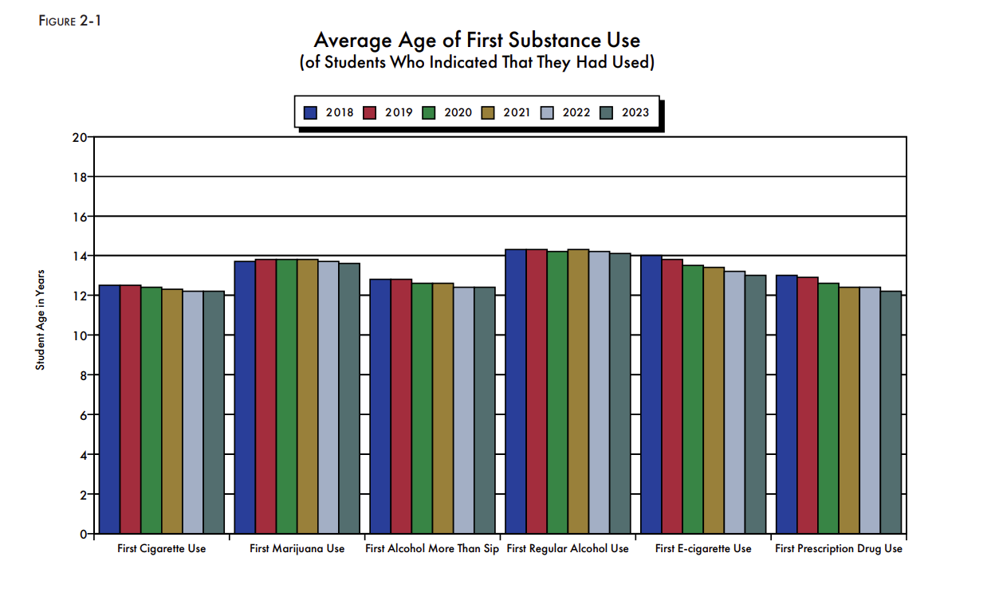
Statistics
Arkansas - APNA Survey
Alcohol
Cigarettes
Smokeless Tobacco
Vaping
Marijuana
Inhalants
Hallucinogens
Cocaine
Methamphetamines
Opiates/Heroin
Prescription Drugs
OTC Drugs
Alcopops
CBD Products
(International Survey Associates, 2023)
Notes:
First, let’s discuss the 2023 APNA survey results, APNA stands for "Arkansas Prevention Needs Assessment”
The APNA survey was created to respond to current trends in drug use and to allow for comparison with national data.
Given to Arkansas students in grades 6, 8, 10, and 12.
It measures the current prevalence of 16 alcohol, tobacco, and other drug substances.
It asked questions regarding where they could obtain these substances and how easy it is, and age of first use.
It also looks at antisocial behaviors and risk factors contributing to substance misuse and antisocial behaviors.
What to gather from this data is the age of first use continues to decline, students are experimenting at even younger ages.
International Survey Associates. (2023). APNA Survey. University of Arkansas at Little Rock MidSOUTH Center for Prevention and Training Funded by Arkansas Department of Human Services Division of Aging, Adult, and Behavioral Health Services, https://arkansas.pridesurveys.com/regions.php?year=2023

Slide 6
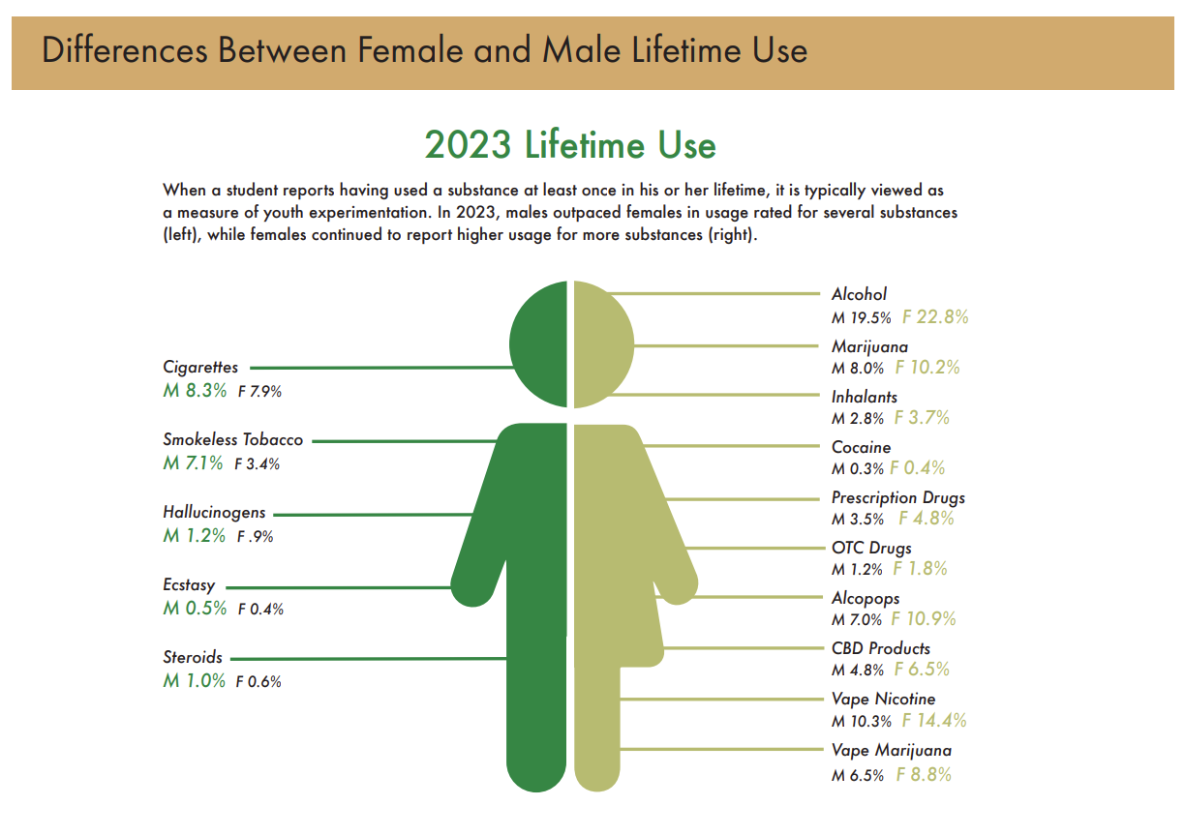
Statistics
Arkansas - APNA Survey
(International Survey Associates, 2023)
Notes:
This slide is another breakdown of the APNA survey data
Let's take a look at the survey results between male and females.
In 2023 this graph shows that males used more, but the females have experimented with more drug categories.
What I want to point out about the results of the 2023 APNA survey is that the roles have reversed, in the past it was males who were more at risk to experiment, now we see that females are more willing.
When a student reports using at least once, this is viewed as experimentation.
What we know about experimentation is that it is derived mostly from peer pressure from other teens.
Once they try an experimental drug like marijuana, nicotine or alcohol and find out the single use doesn't cause significant harm or immediately turns into addiction, they could develop a false sense of security and try more dangerous drugs.
International Survey Associates. (2023). APNA Survey. University of Arkansas at Little Rock MidSOUTH Center for Prevention and Training Funded by Arkansas Department of Human Services Division of Aging, Adult, and Behavioral Health Services, https://arkansas.pridesurveys.com/regions.php?year=2023

Slide 7
Risk Factors
Family history of substance abuse
Mental or behavioral health conditions
Impulsive or risk-taking behavior
Peer pressure
History of traumatic events
Low self-esteem or feelings of social rejection
(Mayo Clinic Staff, 2023)
Notes:
Mental or behavioral health conditions like Depression, anxiety, or ADHD. What we see is that teens tends to self medicate.
Aside from experimentation, self medication can be due from the stigma around mental health, the cost of mental health services but also the lack of access to mental health services.
Reported use for almost all substances decreased dramatically between 2020 and 2021, after the onset of the COVID-19 pandemic and related changes like school closures and social distancing
History of a traumatic event such as a loved one passing away or experiencing abuse.
Mayo Clinic Staff. (2023). Teen drug abuse: help your teen avoid drugs. Mayo Clinic. https://www.mayoclinic.org/healthy-lifestyle/tween-and-teen-health/in-depth/teen-drug-abuse/art-20045921
NIDA. 2023, December 13. Reported drug use among adolescents continued to hold below pre-pandemic levels in 2023. Retrieved from https://nida.nih.gov/news-events/news-releases/2023/12/reported-drug-use-among-adolescents-continued-to-hold-below-pre-pandemic-levels-in-2023 on 2024, June 11
https://www.mayoclinic.org/healthy-lifestyle/tween-and-teen-health/in-depth/teen-drug-abuse/art-20045921

Slide 8
Substance Abuse Risks
Academic failure/drop out
Social isolation
Health problems
Engaging in sexual activity
Engaging in dangerous activities
Legal Issues
Drug addiction
Death
(Bednar et al, 2024)
Notes:
We all know the risk is greater when they begin to mix medicines
Bednar H, McMillan S, Sidibe T, Bennett M. Addressing Adolescent Substance Abuse and Risky Sexual Health Behaviors via Youth-Led Initiatives: A Review of the Teens Linked to Care Pilot Program. Int J Environ Res Public Health. 2024 Feb 22;21(3):252. doi: 10.3390/ijerph21030252. PMID: 38541254; PMCID: PMC10970399.
https://www.ncbi.nlm.nih.gov/pmc/articles/PMC10970399/
https://www.harmonyridgerecovery.com/schools-combating-illicit-substance-abuse/

Slide 9
Route. Reaction. Recognition. Respond.
Notes:
Now its time to dive into some Drug Education, specifically 7 different drug categories, Route, Reaction, Recognition. & Respond.
Route will describe how the drug is consumed.
Reaction will describe what the drug category does in the body.
Recognition will be the signs of symptoms that occur when the teen is under the influence.
Then, we will later go over Respond which is how schools can attempt to combat drug abuse.

Slide 10
CNS Depressants
ROUTE
swallowed, drunk, absorbed, injected , snorted, or inhaled
REACTION
Increases the production of the neurotransmitter GABA, slows down the brain
RECOGNITION
Alcohol
Barbiturates
Benzodiazepines
Sleeping pills
Opioids
(Hilliard, 2024)
Notes:
You should have a quick-look handout in front of you. It serves as a guide to common names of prescription and illicit drugs under each category.
More GABA (gamma-aminobutyric acid) = slows down brain activity
Hillliard, Jena. (2024). Central nervous center depressants. Addiction Center. https://www.addictioncenter.com/drugs/drug-classifications/central-nervous-system-depressants/
https://www.addictioncenter.com/drugs/drug-classifications/central-nervous-system-depressants/

Slide 11
Lowered blood pressure
Dilated pupils
Disorientation
Slowed pulse
Slowed breathing
Sleepiness
Dizziness
Relaxation/euphoria
Signs and Symptoms
(Hilliard, 2024)
Notes:
And when someone is under the influence of a CNS depressant, they could have
Hillliard, Jena. (2024). Central nervous center depressants. Addiction Center. https://www.addictioncenter.com/drugs/drug-classifications/central-nervous-system-depressants/

Slide 12
Memory loss
Slurred speech
Reduced inhibitions
Loss of coordination
Impaired judgement
Blacking out
Overdose
Alcohol smell on breath
Signs and Symptoms
(Hilliard, 2024)
Notes:
Hillliard, Jena. (2024). Central nervous center depressants. Addiction Center. https://www.addictioncenter.com/drugs/drug-classifications/central-nervous-system-depressants/

Slide 13
Alcohol Poisoning
What is alcohol poisoning?
Cold
Clammy skin
Unconsciousness
Puking/particularly when passed out
Slow or irregular breathing
(Reach lab, 2023)
Notes:
Recognizing alcohol poisoning
An abundance of marketing strategies to hide alcohol, like hidden flasks.
It is when someone drinks so much alcohol that it begins to shut down basic life support functions such as breathing, heart rate, and temperature control.
It occurs because many people don’t know how much alcohol is in what they're drinking.
Reach Lab. (2024). Safety First. Stanford Medicine. https://med.stanford.edu/halpern-felsher-reach-lab/curriculum-data-dashboard.html
https://med.stanford.edu/halpern-felsher-reach-lab/curriculum-data-dashboard.html

Slide 14
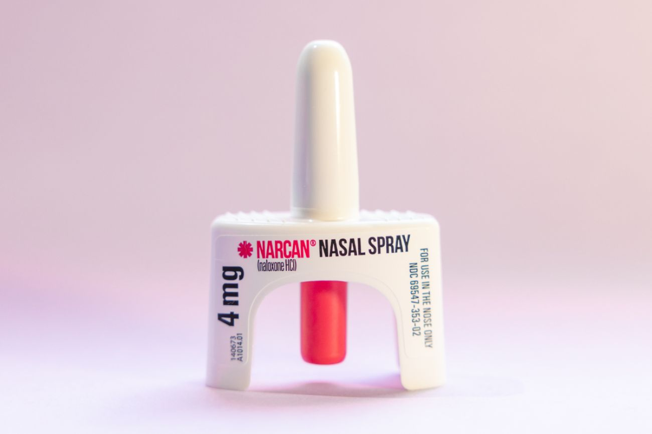
Opioid Overdose
Slow, shallow and erratic breathing
Pinpoint pupils
Snoring or gurgling sounds
Unconscious or unresponsive to stimuli
Limp
Slow pulse/no pulse
Pale or ashen and clammy skin
(Erb, 2023)
(Reach Lab, 2024)
Notes:
Recognizing Overdose
Overdose can occur up to 3 hours after they take it.
Discuss Narcan locations
Narcan training.
Erb, R. (2023). Lifesaving narcan for drug overdoses approved for over the counter sale. Bridge Michican. https://www.bridgemi.com/michigan-health-watch/lifesaving-narcan-drug-overdoses-approved-over-counter-sale

Slide 15
CNS Stimulants
ROUTE
swallowed, snorted, or injected
REACTION
Acts on the CNS to increase alertness and cognitive function (increased dopamine and norepinephrine)
RECOGNITION
Prescription
Illicit
(Buffo, 2024)
Notes:
Mention caffeine/energy drinks
Buffo, J. (2024). Stimulant abuse: signs, effects, and treatment. American Addiction Centers.https://americanaddictioncenters.org/stimulants
https://americanaddictioncenters.org/stimulants

Slide 16
Signs and Symptoms
Euphoria
Decreased appetite
Talkativeness
Energy
Increased concentration
Difficulty sleeping
Nervousness
Increased pulse and blood pressure
(Buffo,2024)
Notes:
Buffo, J. (2024). Stimulant abuse: signs, effects, and treatment. American Addiction Centers.https://americanaddictioncenters.org/stimulants

Slide 17
Hallucinogens
ROUTE
swallowed, eaten, drunk, smoked, snorted, absorbed or inhaled
REACTION
Psychedelic drugs cause a disruption in processing serotonin
Dissociative drugs causes a disruption in processing glutamate
RECOGNITION
Psychedelic
Dissociative
Non-Classified
(Miller, 2023)
Notes:
Processing serotonin= affects a person's sense of self and result in visual changes (hallucinations)
Processing glutamate= feeling disconnected from your body and surroundings (out of body experience)
They come from plants or fungi
Absorbed = under the tongue or in the cheek
Miller, L. (2023). Hallucinogen addiction: types of effects of mind-altering dugs. American Addiciton Centers. https://americanaddictioncenters.org/hallucinogens

Slide 18
Signs and Symptoms
Hard to predict**
Hallucinations causing intense emotions, seeing visions, smelling items and hearing sounds that are not present
Dilated pupils
Increased blood pressure
Increased body temperature/sweating
Loss of appetite
Fear, depression, anxiety, and paranoia can become semi-permanent
(Miller, 2023)
Notes:
Varies widely based on age, sex, weight, previous use, environment
Miller, L. (2023). Hallucinogen addiction: types of effects of mind-altering dugs. American Addiciton Centers. https://americanaddictioncenters.org/hallucinogens

Slide 19
Inhalants
ROUTE
"huffing" or directly from container into mouth or nose
REACTION
Slow down the workings of the brain, they enter the bloodstream very quickly
RECOGNITION
Solvents
Aerosols
Gases
Nitrites
(Miller, 2024)
Notes:
Inhalants are easy to acquire as most are household products.
Studies show that inhalant use is more prevalent among teens
"Huffing" through a rag or directly from the container, could inhale it out of a plastic or paper bag
Miller, L. (2024). Inhalant addiction: signs, effects, and treatment. American Addiction Center. https://americanaddictioncenters.org/inhalant-abuse

Slide 20
Excitability
Euphoria
Hallucinations
Loss of self-control
Lightheadedness
Dizziness
Limited reflexes
Loss of coordination
Signs and Symptoms
(Miller, 2024)
Notes:
Miller, L. (2024). Inhalant addiction: signs, effects, and treatment. American Addiction Center. https://americanaddictioncenters.org/inhalant-abuse

Slide 21
Signs and Symptoms
Slurred or distorted speech
Blacking out
(Miller, 2024)
Notes:
A headache can usually follow
Miller, L. (2024). Inhalant addiction: signs, effects, and treatment. American Addiction Center. https://americanaddictioncenters.org/inhalant-abuse

Slide 22
Cannabis
ROUTE
smoked/vaporized, edibles, drunk, topical
REACTION
THC = psychoactive chemical in marijuana
RECOGNITION
(Webster, 2024)
Notes:
The results of marijuana use is how it acts on the brain.
THC = the psychoactive chemical in marijuana, blood carries THC to the brain where it acts on a cannabinoid receptor which in-turn slows down the body and brain which is why it is associated with a relaxing and calming effect.
How longs does a high last? It can generally last up to a few hours, but it depends on how it was consumed and the user's level of tolerance.
Tonics: teas, tinctures: serums/topical
Wax form or dabbing: inhaled
CBD versus THC
Webster, A. (2024). Marijuana addiction: effects signs, and rehab treatment. American Addiction Centers. https://americanaddictioncenters.org/marijuana-rehab

Slide 23
Signs and Symptoms
Red eyes
Poor muscle coordination
Delayed reaction times
Increased appetite
Panic/anxiety
Smell it on their clothing
(Webster, 2024)
Notes:
Don't forget marijuana has a distinctive smell almost "skunk-like" You could get a whiff of it on a person's clothes or hair.
Webster, A. (2024). Marijuana addiction: effects signs, and rehab treatment. American Addiction Centers. https://americanaddictioncenters.org/marijuana-rehab

Slide 24
Tobacco/Nicotine
ROUTE
smoked, absorbed, or inhaled
REACTION
Absorbed into your bloodstream and goes to your adrenal glands, over time it changes the way your brain works.
RECOGNITION
(NIDA, 2019)
Notes:
Tobacco is a leafy plant grown all around the world.
Tobacco is used by so many people because it contains a powerful drug called nicotine. Nicotine is highly addictive.
In 2023, e-cigarettes were the most commonly used tobacco product among middle and high school students in the US
In this same survey, nearly 1 in 2 US youth who have tried e-cigarettes report current use.
This is how prevalent tobacco use is. We know that tobacco marketing targets youth, that coupled with accessibility, flavored products, social influences, and the teen brain sensitivity to nicotine makes our approach to cessation and counseling that much more needed.
When it changes the way your brain works, it results in addiction/dependence
NIDA. (2019). Mind matters: the body's respone to nicotine, tobacco, and vaping. National Institutes of Health. https://nida.nih.gov/research-topics/parents-educators/lesson-plans/mind-matters/nicotine-tobacco-vaping#:~:text=How%20does%20nicotine%20work%3F,good%20feelings%20all%20at%20once.

Slide 25
Signs and Symptoms
Increases blood pressure
Increases breathing
Increases heart rate
Relaxation
Smell of smoke on their clothes
(NIDA, 2019)
Notes:
Discuss first use versus chronic use, vaping and the amount of Nicotine
NIDA. (2019). Mind matters: the body's respone to nicotine, tobacco, and vaping. National Institutes of Health. https://nida.nih.gov/research-topics/parents-educators/lesson-plans/mind-matters/nicotine-tobacco-vaping#:~:text=How%20does%20nicotine%20work%3F,good%20feelings%20all%20at%20once.
..

Slide 26
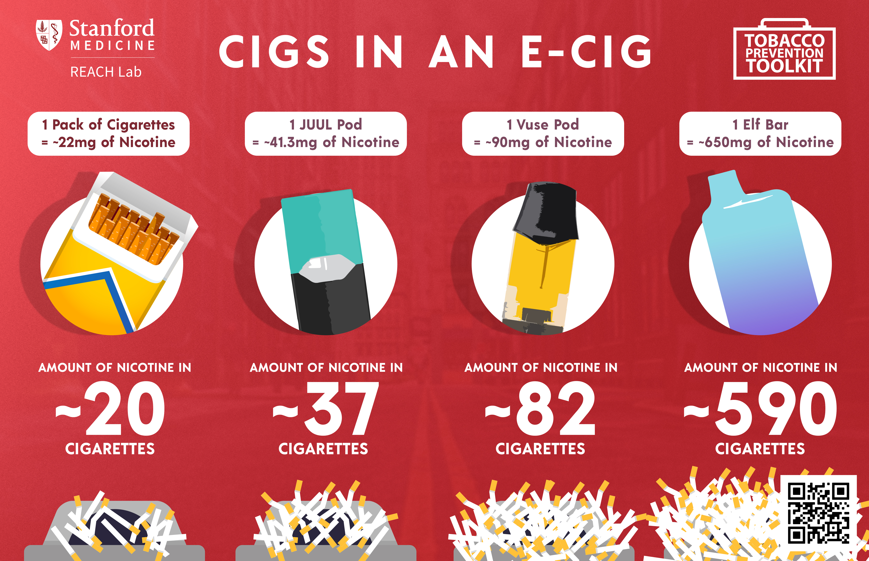
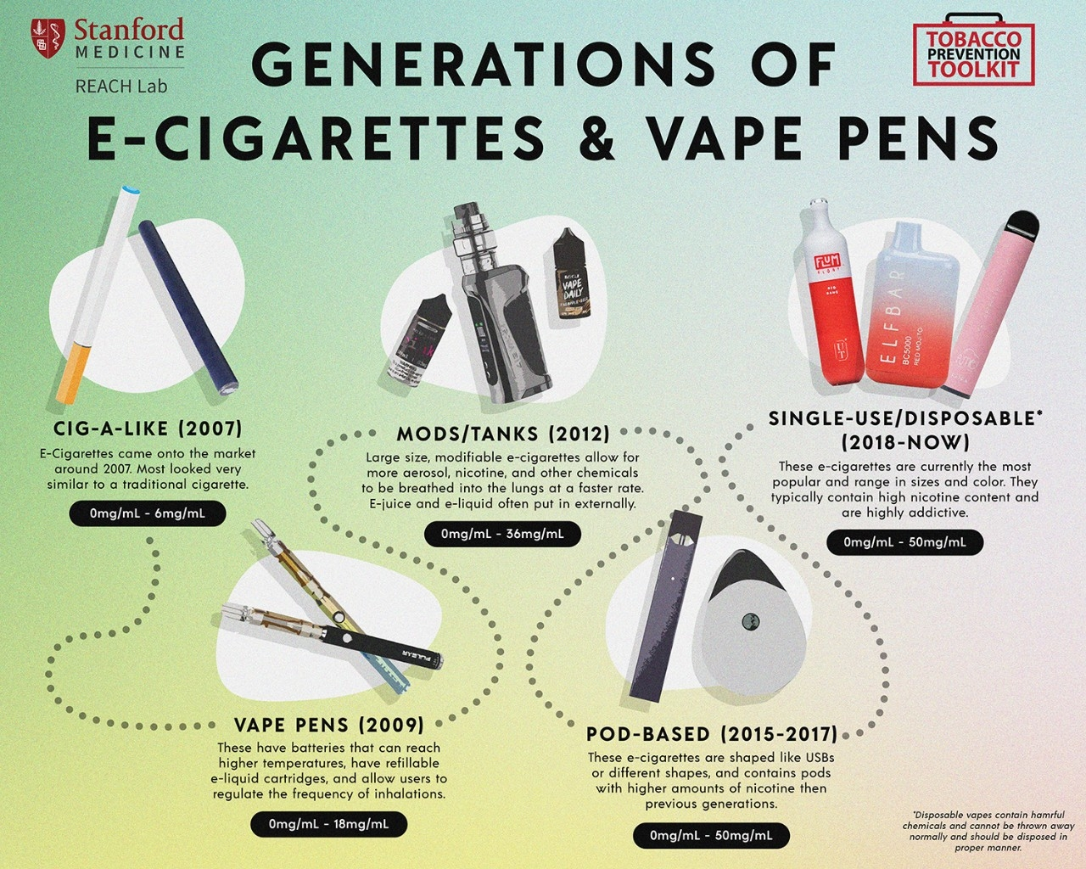
(Reach Lab, 2024)
Notes:
E-cigarettes can also be used to deliver other substances, including cannabis. In 2016, nearly one in three (30.6%) of U.S. middle and high school students who had ever used an e-cigarette reported using marijuana in the device
Reach Lab. (2024). Safety First. Stanford Medicine. https://med.stanford.edu/halpern-felsher-reach-lab/resources.html

Slide 27
Synthetics
Emerging public health concern
Cannot be detected in drug screens
Unregulated
Unpredictable
Cannabinoids
Cathinones
Opioids
(Debnam, 2018)
Notes:
Synthetic cannabinoids typically include over 200 different individual compounds, which makes them difficult to test for, These substances are sometimes marketed as incense or potpourri and referred to as K2 and Spice, They have a high binding affinity to CB1 and CB2 cannabinoid receptors that are very similar to that of plant-based marijuana; however, the use of these substances is often associated with a larger number of immediate somatic and psychoactive effects.
These substances are most popularly known as bath salts but are also marketed as plant food and glass cleaners. This class of drugs is comprised of some 20 or so different compounds that have binding activity similar to that of methamphetamines and MDMA
Commercially available drugs including the synthetic cannabinoids and cathinones may be considered an alternative substance for young people who are closely monitored for substance use because of involvement in drug treatment, the criminal justice system, and military recruitment, since many synthetic drugs cannot be detected in drug screens
changing state laws regarding marijuana use may also signal to some youth that illicit substances may not be as harmful as previously purported. Given shifting societal norms regarding the acceptability of drug use, there is increasing concern about adolescents’ use of synthetic drugs
2023 data continue to document stable or declining trends in the use of illicit drugs among young people over many years. However, importantly, other research has reported a dramatic rise in overdose deaths among teens between 2010 to 2021, which remained elevated well into 2022 according to a NIDA analysis of CDC and Census data. This increase is largely attributed to illicit fentanyl, a potent synthetic drug, contaminating the supply of counterfeit pills made to resemble prescription medications
Debnam KJ, Saha S, Bradshaw CP. Synthetic and Other Drug Use among High School Students: The Role of Perceived Prevalence, Access, and Harms. Subst Use Misuse. 2018 Oct 15;53(12):2069-2076. doi: 10.1080/10826084.2018.1455699. Epub 2018 Apr 6. PMID: 29624111; PMCID: PMC6136142.
https://www.cdc.gov/mmwr/volumes/69/su/su6901a5.htm

Slide 28
RESPOND
Education and prevention efforts
Enforcing rules and policies (deterrence effect)
Early intervention and referral services
Supporting student well-being
Peer support programs
Student-led initiatives
Parental involvement
Protocols
(Addiction Prevention, 2023)
Notes:
What can schools do to combat drug abuse?
Peer support groups are emerging
Addiction Prevention. (2023). The role in schools combatting illicit substance abuse. Harmony Ridge. https://www.harmonyridgerecovery.com/schools-combating-illicit-substance-abuse/#:~:text=Schools%20can%20offer%20drug%20education,pressure%20and%20make%20healthy%20choices.

Slide 29
Protocol
Contact the Office
Inform them of your suspicion
Request escort
Attempt to keep it confidential
Stable student versus unconscious
Notes:
If you suspect that a student is under the influence, does your school have a protocol in place?
What does the nurse referral look like? Where should the assessment be taken place? Who is in the room?
Teacher versus Nurse versus Principal versus SRO
Is your staff aware of how to give life saving measures or first aid? Do they know where your AEDs are located?
Do they know where your NARCAN is located?

Slide 30
References
Addiction Prevention. (2023). The role in schools combatting illicit substance abuse. Harmony Ridge. https://www.harmonyridgerecovery.com/schools-combating-illicit-substance-abuse/#:~:text=Schools%20can%20offer%20drug%20education,pressure%20and%20make%20healthy%20choices.
Buffo, J. (2024). Stimulant abuse: signs, effects, and treatment. American Addiction Centers. https://americanaddictioncenters.org/stimulants
Erb, R. (2023). Lifesaving narcan for drug overdoses approved for over-the-counter sale. Bridge Michican. https://www.bridgemi.com/michigan-health-watch/lifesaving-narcan-drug-overdoses-approved-over-counter-sale
Hillliard, Jena. (2024). Central nervous center depressants. Addiction Center. https://www.addictioncenter.com/drugs/drug-classifications/central-nervous-system-depressants/
International Survey Associates. (2023). APNA Survey. University of Arkansas at Little Rock MidSOUTH Center for Prevention and Training Funded by Arkansas Department of Human Services Division of Aging, Adult, and Behavioral Health Services, https://arkansas.pridesurveys.com/regions.php?year=2023
Mayo Clinic Staff. (2023). Teen drug abuse: help your teen avoid drugs. Mayo Clinic. https://www.mayoclinic.org/healthy-lifestyle/tween-and-teen-health/in-depth/teen-drug-abuse/art-20045921
Miller, L. (2023). Hallucinogen addiction: types of effects of mind-altering dugs. American Addiction Centers. https://americanaddictioncenters.org/hallucinogens
Miller, L. (2024). Inhalant addiction: signs, effects, and treatment. American Addiction Center. https://americanaddictioncenters.org/inhalant-abuse
NIDA. (2019). Mind matters: the body's response to nicotine, tobacco, and vaping. National Institutes of Health. https://nida.nih.gov/research-topics/parents-educators/lesson-plans/mind-matters/nicotine-tobacco-vaping#:~:text=How%20does%20nicotine%20work%3F,good%20feelings%20all%20at%20once.
NIDA. 2023, December 13. Reported drug use among adolescents continued to hold below pre-pandemic levels in 2023. Retrieved from https://nida.nih.gov/news-events/news-releases/2023/12/reported-drug-use-among-adolescents-continued-to-hold-below-pre-pandemic-levels-in-2023 on 2024, June 11
Reach Lab. (n.d.). Nicotine and Tobacco. Stanford Medicine. https://med.stanford.edu/halpern-felsher-reach-lab/resources.html
Webster, A. (2024). Marijuana addiction: effects signs, and rehab treatment. American Addiction Centers. https://americanaddictioncenters.org/marijuana-rehab

Slide 31
Thank you!

